Slide 1
Architectures with Machine Learning Components
Christian Kaestner

Slide 2
Learning Goals
Understand basic components of an ML pipeline
Understand important quality considerations when using ML components
Gather data to make informed decisions about what ML technique to use and where and how to deploy it
Deliberate how and when to update models and how to collect telemetry
Plan for ML mistakes

Slide 3
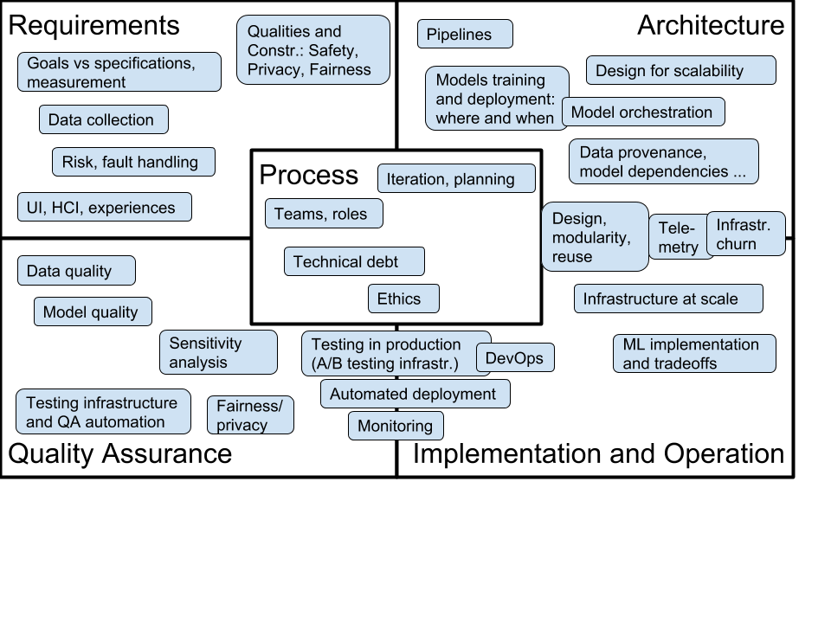
Fall 2019: New Course: Software Engineering for AI-Enabled Systems
What changes with AI?
Requirements
Architecture
Operations
Quality assurance
Process
Going beyond Jupyter notebooks, operating AI-enabled systems in practice at scale
Software engineering view on AI/ML craze
https://ckaestne.github.io/seai/

Slide 4
Case Study

Slide 5


Slide 6


Slide 7


Slide 8
Qualities of Interest?

Slide 9
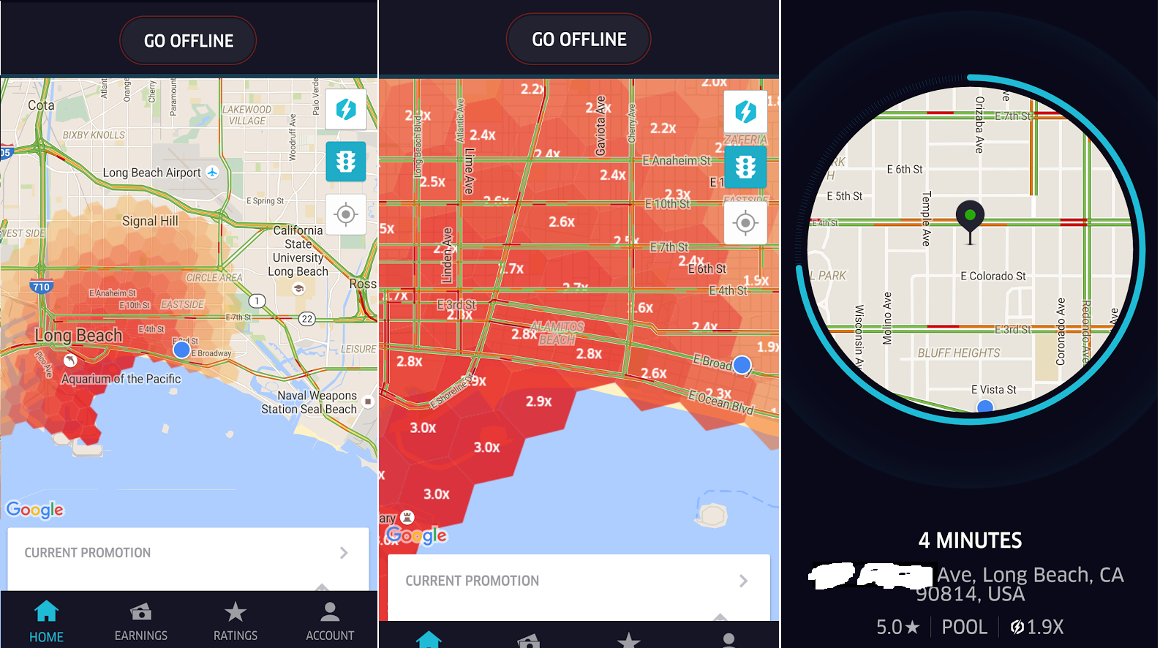

Slide 10
Qualities of Interest?

Slide 11
Machine Learning Pipeline

Slide 12
Typical ML Pipeline
Static
Get labeled data
Identify and extract features
Split data into training and evaluation set
Learn model from training data
Evaluate model on evaluation data
Repeat, revising features
With production data
Evaluate model on production data; monitor
Select production data for retraining
Update model regularly

Slide 13
Example Data
UserId | PickupLocation | TargetLocation | OrderTime | PickupTime
5 | …. | … | 18:23 | 18:31
…

Slide 14
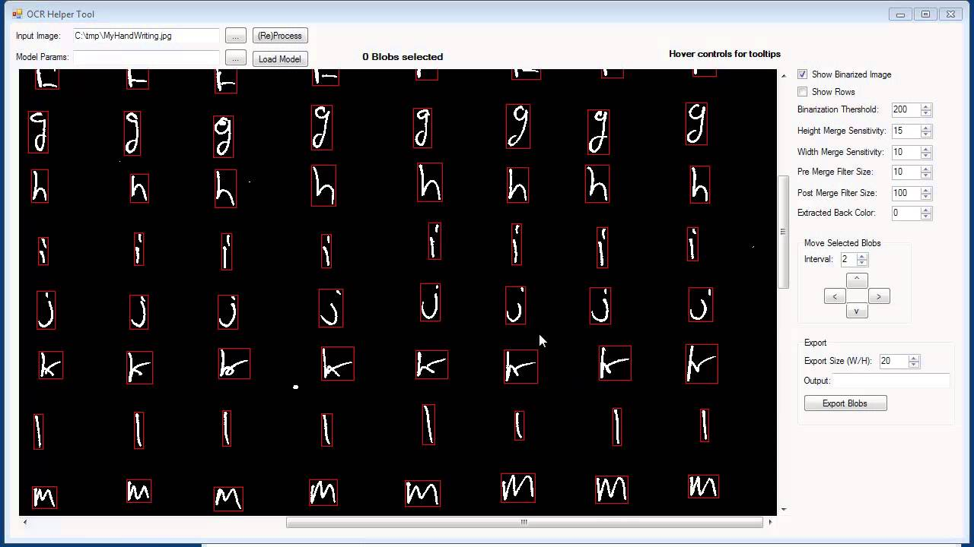
Example Data

Slide 15
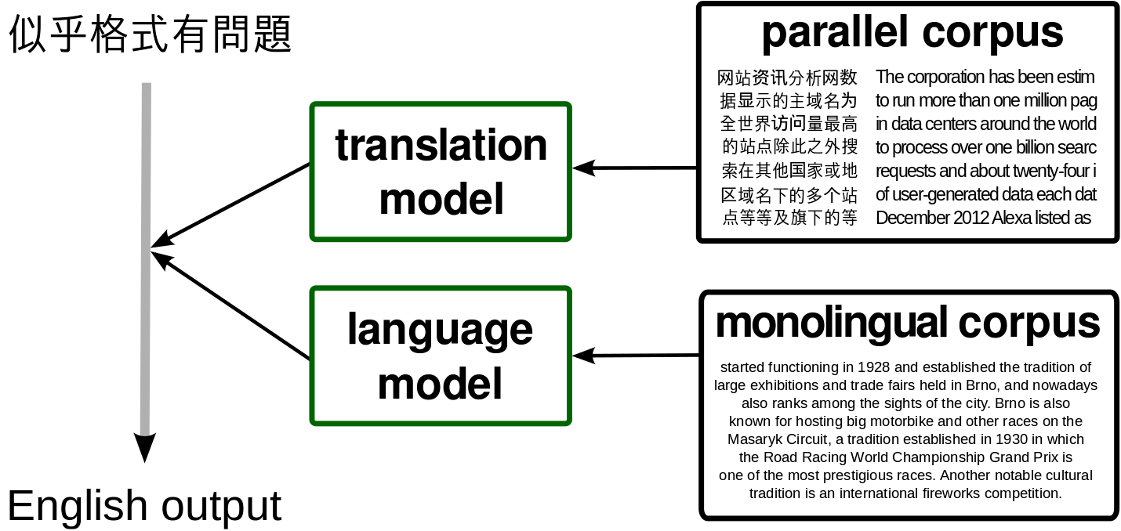
Learning Data

Slide 16
Training Data

Slide 17
Feature Engineering
Identify parameters of interest that a model may learn on
Convert data into a useful form
Normalize data
Include context
Remove misleading things
In OCR/translation:

Slide 18
Features?

Slide 19
Features?

Slide 20
Feature Extraction
In surge prediction:
Location and time of past surges
Events
Number of people traveling to an area
Typical demand curves in an area
Demand in other areas

Slide 21
Data Cleaning
Removing outliers
Normalizing data
Missing values
…

Slide 22
Learning
Build a predictor that best describes an outcome for the observed features

Slide 23
Evaluation
Prediction accuracy on learned data vs
Prediction accuracy on unseen data
Separate learning set, not used for training
For binary predictors: false positives vs false negatives, recall, precision
For numeric predictors: average (relative) distance between real and predicted value
For ranking predictors: topK etc

Slide 24
Evaluation Data?

Slide 25
Evaluation Data?

Slide 26
Learning and Evaluating in Production
Beyond static data sets, build telemetry
Design challenge: identify mistakes in practice
Use sample of live data for evaluation
Retrain models with sampled live data regularly
Monitor performance and intervene

Slide 27
ML Component Tradeoffs

Slide 28
Qualities of ML Components
Accuracy
Capabilities (e.g. classification, recommendation, clustering…)
Amount of training data needed
Inference latency
Learning latency; incremental learning?
Model size
Explainable? Robust?
…

Slide 29
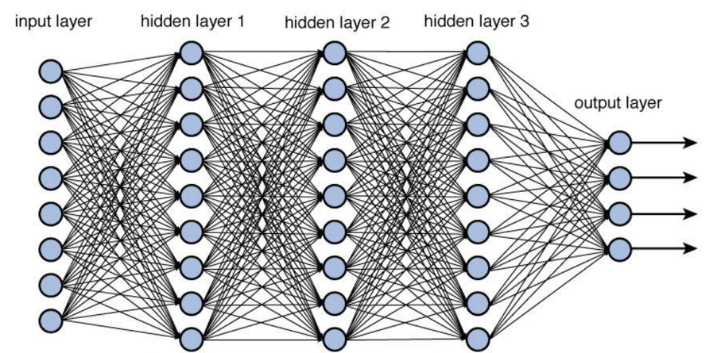
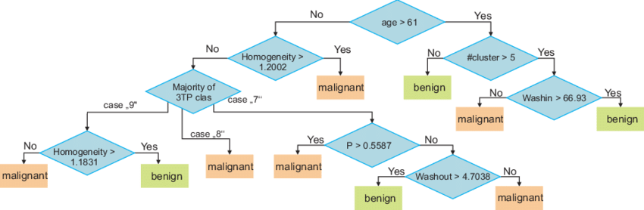
Understanding Capabilities and Tradeoffs
Deep Neural Networks
Decision Trees

Slide 30
System Architecture Considerations

Slide 31
Where should the model live?
Glasses
OCR Component
Phone
Translation Component
Cloud

Slide 32
Where should the model live?
Car
Surge Prediction
Phone
Cloud

Slide 33
Considerations
How much data is needed as input for the model?
How much output data is produced by the model?
How fast/energy consuming is model execution?
What latency is needed for the application?
How big is the model? How often does it need to be updated?
Cost of operating the model? (distribution + execution)
Opportunities for telemetry?
What happens if users are offline?

Slide 34
Typical Designs
Static intelligence in the product
difficult to update
good execution latency
cheap operation
offline operation
no telemetry to evaluate and improve
Client-side intelligence
updates costly/slow, out of sync problems
complexity in clients
offline operation, low execution latency

Slide 35
Typical Designs
Server-centric intelligence
latency in model execution (remote calls)
easy to update and experiment
operation cost
no offline operation
Back-end cached intelligence
precomputed common results
fast execution, partial offline
saves bandwidth, complicated updates
Hybrid models

Slide 36
Other Considerations
Coupling of ML pipeline parts
Coupling with other parts of the system
Ability for different developers and analysists to collaborate
Support online experiments
Ability to monitor

Slide 37
Reactive System Design Goals
Responsive
consistent, high performance
Resilient
maintain responsive in the face of failure, recovery, rollback
Elastic
scale with varying loads

Slide 38
Common Design Strategies
Message-driven, lazy computation, functional programming
asynchronous, message passing style
Replication, containment, supervision
replicate and coordinate isolated components, e.g. with containers
Data streams, “infinite data”, immutable facts
streaming technologies, data lakes
See “big data systems” and “cloud computing”

Slide 39
Making Decisions
What steps to take?
What information to collect?

Slide 40
Updating Models

Slide 41
Updating Models
Models are rarely static outside the lab
Data drift, feedback loops, new features, new requirements
When and how to update models?
How to version? How to avoid mistakes?

Slide 42
Latency and automation vary widely
Heavily distributed
Server
serving
Models
other
features
(e.g weather)
logs
Data Stream
(e.g. Kafka)
Stream Processing
incremental
learning
archival
Data Lake
Analytics
(OLAP)
learning in nightly
batch processing

Slide 43
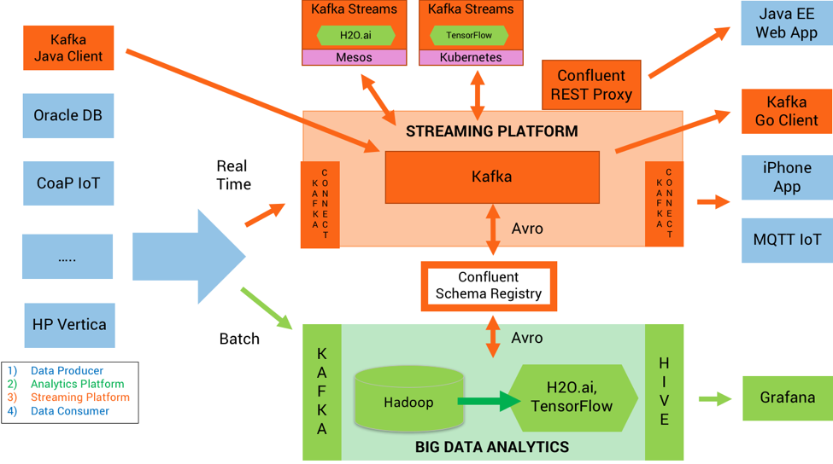

Slide 44
Update Strategy?

Slide 45
Update Strategy?

Slide 46
Making Decisions
What steps to take?
What information to collect?

Slide 47
Planning for Mistakes

Slide 48
Mistakes will happen
No specification
ML components detect patterns from data (real and spurious)
Predictions are often accurate, but mistakes always possible
Mistakes are not predicable or explainable or similar to human mistakes
Plan for mistakes
Telemetry to learn about mistakes?

Slide 49
How Models can Break
System outage
Model outage
model tested? deployment and updates reliable? file corrupt?
Model errors
Model degradation
data drift, feedback loops

Slide 50
Hazard Analysis
Worst thing that can happen?
Backup strategy? Undoable? Nontechnical compensation?

Slide 51
Mitigating Mistakes
Investigating in ML
e.g., more training data, better data, better features, better engineers
Less forceful experience
e.g., prompt rather than automate decisions, turn off
Adjust learning parameters
e.g., more frequent updates, manual adjustments
Guardrails
e.g., heuristics and constraints on outputs
Override errors
e.g., hardcode specific results

Slide 52
Mistakes?

Slide 53
Mistakes?

Slide 54
Telemetry
Purpose:
monitor operation
monitor success (accuracy)
improve models over time (e.g., detect new features)
Challenges:
too much data – sample, summarization, adjustable
hard to measure – intended outcome not observable? proxies?
rare events – important but hard to capture
cost – significant investment must show benefit
privacy – abstracting data

Slide 55
Model Orchestration
Multiple models work together
ORC + statistical translation
driver activity predictor + demand predictor + event predictor + weather model
model + railguards
Many different composition strategies
ensemble learning
integrated models
model sequencing
partitioning

Slide 56
Fall 2019: New Course: Software Engineering for AI-Enabled Systems
What changes with AI?
Requirements
Architecture
Operations
Quality assurance
Process
Going beyond Jupyter notebooks, operating AI-enabled systems in practice at scale
Software engineering view on AI/ML craze
https://ckaestne.github.io/seai/

Slide 57
Summary
Machine learning in production systems is challenging
Many tradeoffs in selecting ML components and in integrating them in larger system
Plan for updates
Manage mistakes, plan for telemetry

Slide 58
Recommended Reading
Geoff Hulten. Building Intelligent Systems: A Guide to Machine Learning Engineering. Apress 2018

